Slide 1


Difference between Spreadsheets and Databases
Spreadsheets (Excel) are electronic ledgers
  Store, manipulate and present numbers
Databases (Access) are electronic file cabinets
  Receive, store, organize and present data
Use the right application
  Save time and effort
  Decrease frustration

Slide 2

Database abstraction
A database is a repository of data
  Only two things to do
    Put data in
      Forms -> Records
    Get data out
      Records -> reports
      Query -> records -> reports
  Think of the database is a bucket of data
    As long as you can put stuff and get the right stuff out who cares what happens in the bucket

Slide 3
Advanced Access
Doing Queries using QBE
Importing Spreadsheets to create Access tables
Exporting Access Table and Queries as Excel Workbooks

Slide 4
Quick Intro to databases

Slide 5
Some Vocabulary
A Field is a basic fact
A Record is a set of fields
A Table is set of records
A Database is one or more tables
Forms are used to create records in tables based on user inputs
Queries are questions applied to the Database
Reports are preformatted query results

Slide 6
Introduction to a Database
Defining a database
Database window in Access
The six items in window: Tables, Queries, Forms, Reports, Macros, Modules

Slide 7
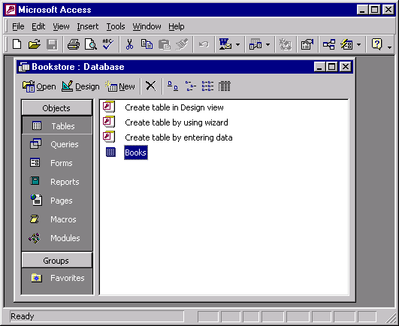
Database Window
Menu Bar
Toolbar
Database
Window
Object Buttons

Slide 8
Tables
Design view used to create fields
Datasheet view used to add, edit, or delete records
Each column represents a field
Records are recorded in rows

Slide 9
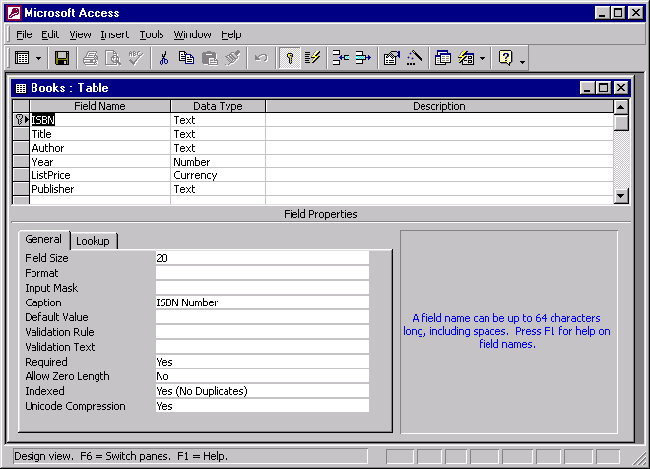
Design View
Primary Key
Field Names
Data Type
Description
Field
Properties

Slide 10
Tables In Database View
Record selector symbol next to current record shows status
Triangle indicates saved to disk
Pencil indicates you are typing
Asterisk appears next to last blank record in table

Slide 11
Tables
Insertion point: where text is entered
Primary key: unique identifier for each record
Access automatically saves changes when you move to next record

Slide 12
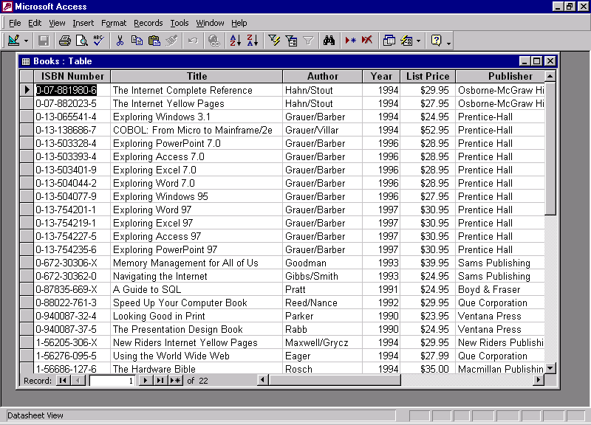
Datasheet View
Triangle indicates
Data has been
saved to disk
Current Record
Total Number of Records

Slide 13
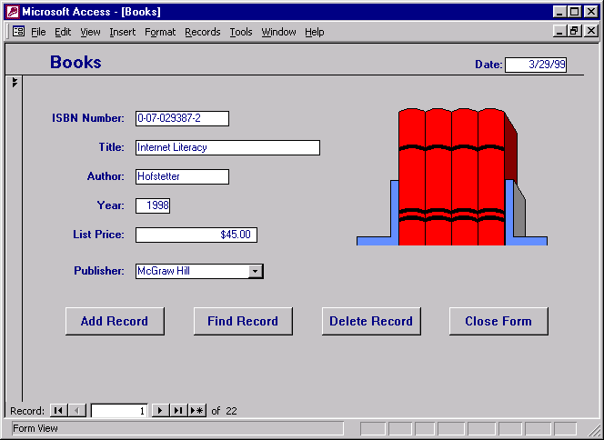
Database Form
Command
Buttons
Go To
First Record
Go To Next Record
Go To Last Record

Slide 14
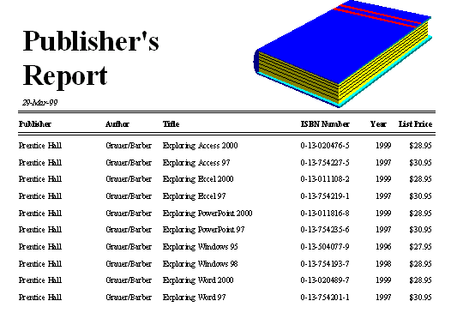
Report

Slide 15
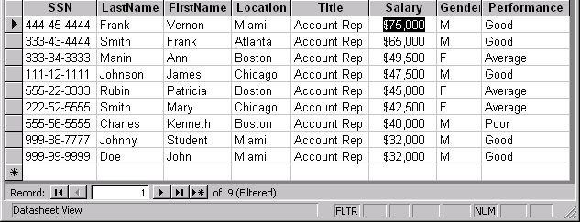
Filter By Selection
These Records Were Sorted in Descending Order by Salary
Only 9 of 15 Total Records Are Displayed In This Filter

Slide 16
Access Project 1
Creating and Using a Database

Slide 17
Objectives
Describe databases and database management systems
Start Access
Describe the features of the Access desktop
Create a database
Create a table and add records

Slide 18
Objectives
Close a table
Close a database and quit Access
Open a database
Print the contents of a table

Slide 19
Objectives
Create and use a simple query
Create and use a simple form
Create and print a custom report
Design a database to eliminate redundancy

Slide 20
Starting Access
Click the Start button on the Windows taskbar, point to All Programs on the Start menu, and then point to Microsoft Office on the All Programs submenu
Click Microsoft Office Access 2003
If the Access window is not maximized, double-click its title bar to maximize it

Slide 21
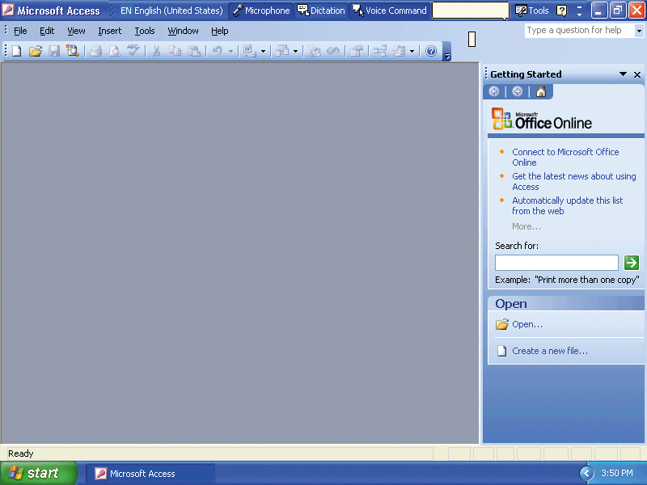
Starting Access

Slide 22
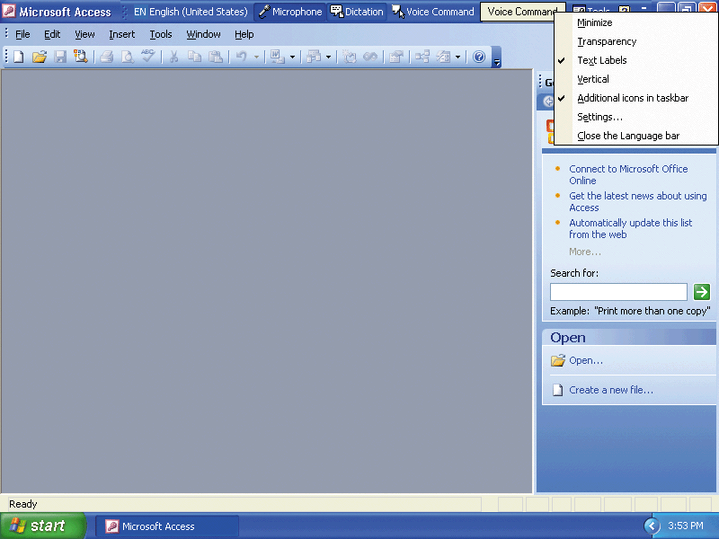
Closing the Language Bar
Right-click the Language bar to display a list of commands
Click Close on the Language bar
Click the OK button

Slide 23
Creating a New Database
Click the New button on the Database toolbar to display the task pane
Click the Blank Database option in the task pane, and then click the Save in box arrow
Save on H:\ or X:\

Slide 24
Creating a New Database
Click the File name text box
Use the BACKSPACE key or the DELETE key to delete db1 and then type Ashton James College as the file name
Click the Create button to create the database

Slide 25
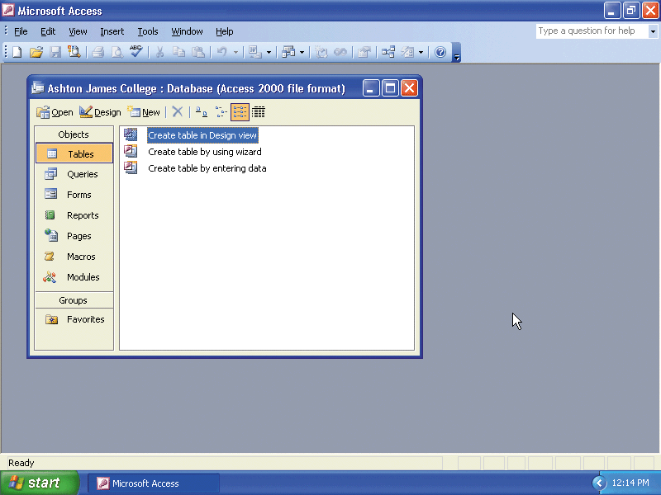
Creating a New Database

Slide 26
Creating a Table
Click the New button on the Database window toolbar
Click Design View and then click the OK button
Double-click the title bar of the Table1 : Table window to maximize the window

Slide 27
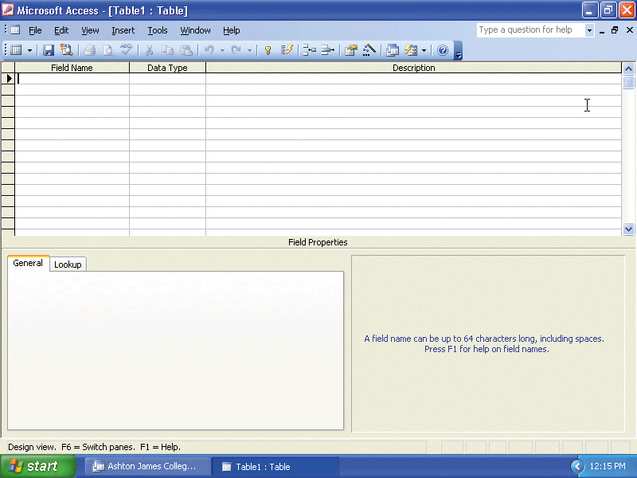
Creating a Table

Slide 28
Defining the Fields in a Table
Type Client Number (the name of the first field) in the Field Name column and then press the TAB key
Because Text is the correct data type, press the TAB key to move the insertion point to the Description column, type Client Number (Primary Key) as the description, and then click the Primary Key button on the Table Design toolbar
Press the F6 key
Type 4 as the size of the Client Number field
Press the F6 key to return to the Description column for the Client Number field, and then press the TAB key to move to the Field Name column in the second row

Slide 29
Defining the Fields in a Table
Use the techniques illustrated in the previous four steps to make the entries from the Client table structure shown on the following slide, up through and including the name of the Amount Paid field
Click the Data Type box arrow
Click Currency and then press the TAB key
Make the remaining entries from the Customer table structure shown on the following slide

Slide 30
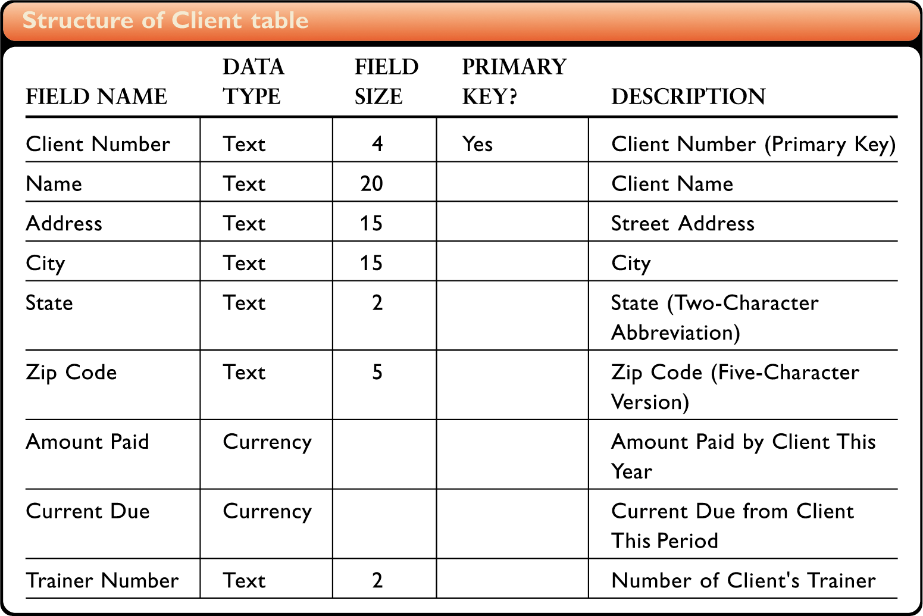
Defining the Fields in a Table

Slide 31
Closing and Saving a Table
Click the Close Window button for the Table1 : Table window (Be sure not to click the Close button on the Microsoft Access title bar, because this would close Microsoft Access)
Click the Yes button in the Microsoft Office Access dialog box, and then type Client as the name of the table
Click the OK button in the Save As dialog box

Slide 32
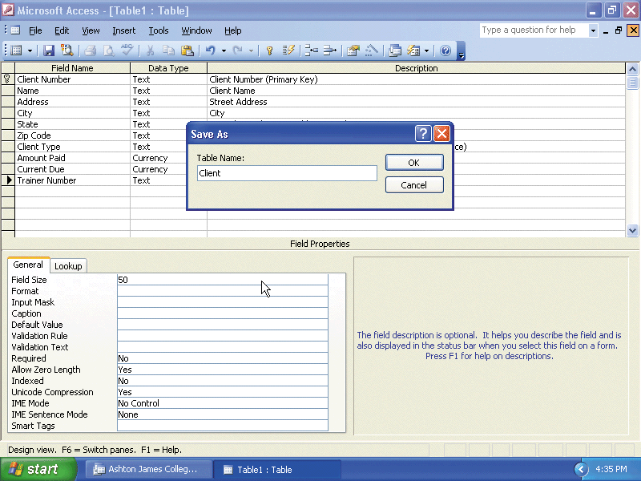
Closing and Saving a Table

Slide 33
Adding Records to a Table
Right-click the Client table in the Ashton James College : Database window
Click Open on the shortcut menu
Type BS27 as the first customer number. Be sure you type the letters in uppercase so they are entered in the database correctly
Press the TAB key to complete the entry for the Client Number field
Type the following entries, pressing the TAB key after each one: Blant and Sons as the name, 4806 Park as the address, Hammond as the city, TX as the state, and 76653 as the zip code

Slide 34
Adding Records to a Table
Type 21876 as the Amount Paid amount and then press the TAB key
Type 892.50 as the current due amount and then press the TAB key
Type 42 as the trainer number to complete data entry for the record
Press the TAB key
Use the techniques shown in the previous four steps to add the data for the second record shown on the following slide

Slide 35
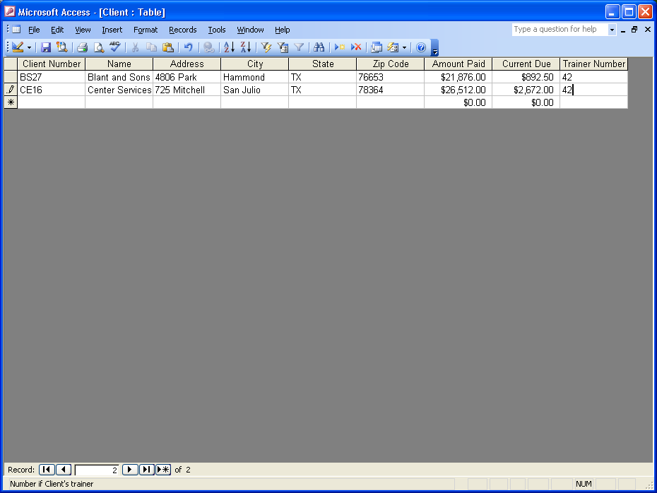
Adding Records to a Table

Slide 36
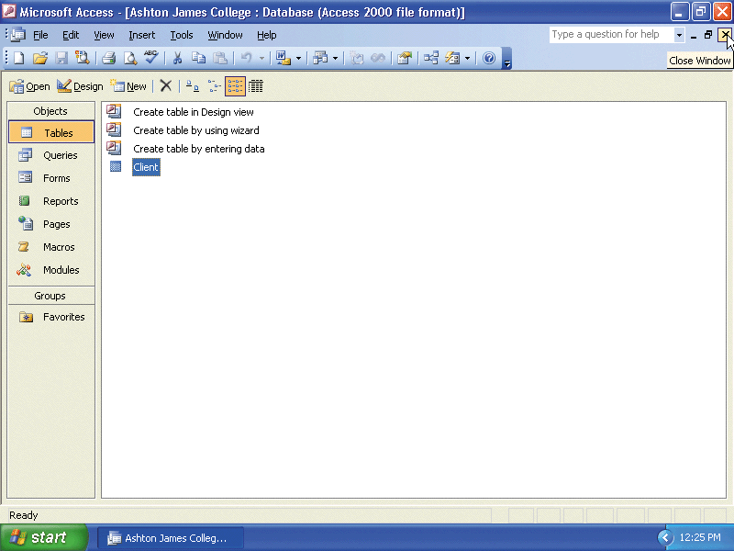
Closing a Table and Database and Quitting Access
Click the Close Window button for the Client : Table window
Click the Close Window button for the Ashton James College : Database window
Click the Close button for the Microsoft Access window

Slide 37
Opening a Database
Start Access following the steps on slide 4
If the task pane appears, click its Close button
Click the Open button on the Database toolbar

Slide 38
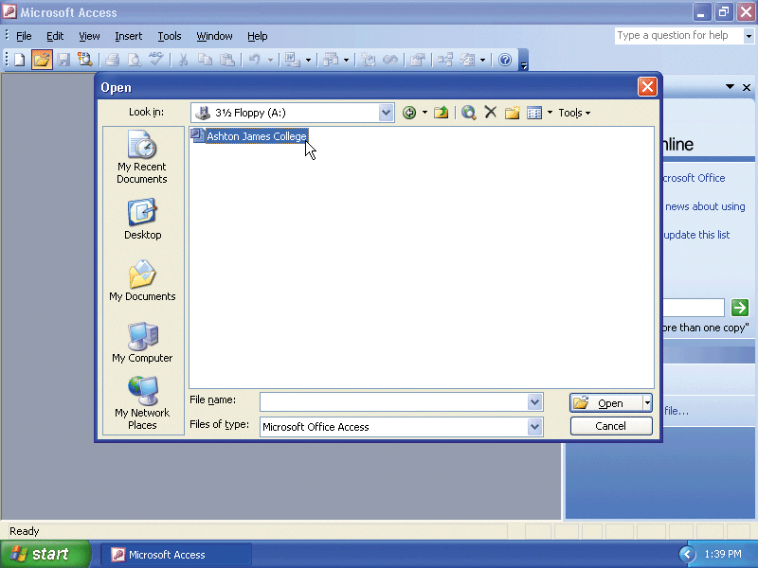
Opening a Database
Be sure 3½ Floppy (A:) folder appears in the Look in box. If not, click the Look in box arrow and click 3½ Floppy (A:)
Click Ashton James College
Click the Open button in the Open dialog box

Slide 39
Adding Additional Records to a Table
Right-click the Client table in the Ashton James College : Database window, and then click Open on the shortcut menu
When the Client table appears, maximize the window by double-clicking its title bar
Click the New Record button
Add the remaining records shown on the following slide using the same techniques you used to add the first two records
Click the Close Window button for the datasheet

Slide 40
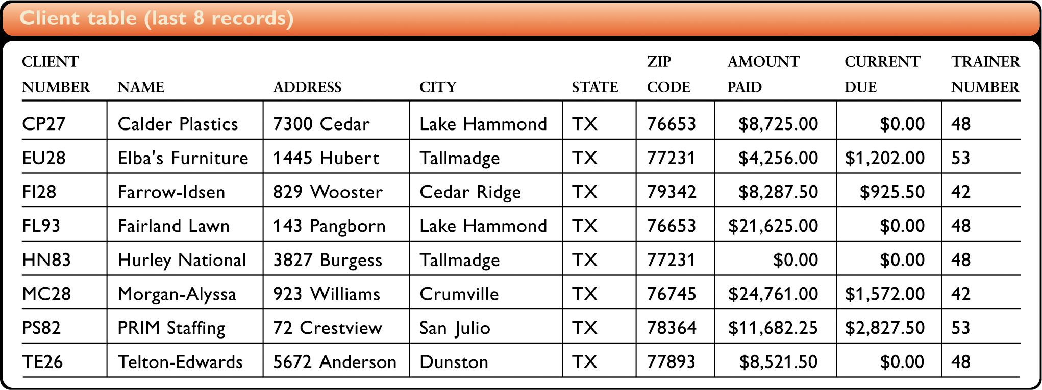
Adding Additional Records to a Table

Slide 41
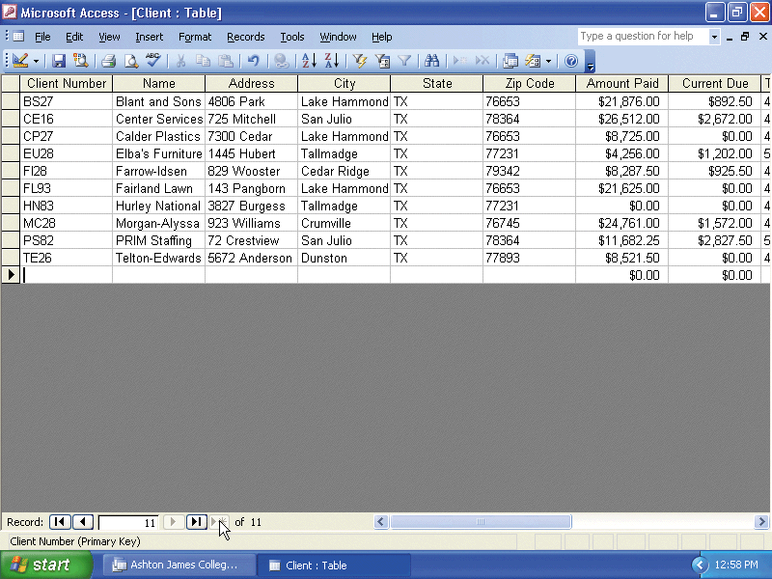
Adding Additional Records to a Table

Slide 42
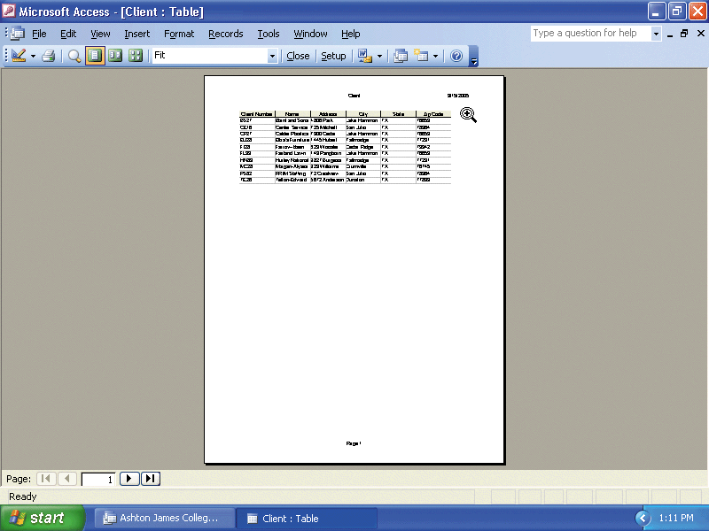
Previewing and Printing the Contents of a Table
Right-click the Client table
Click Print Preview on the shortcut menu
Point to the approximate position shown here

Slide 43
Previewing and Printing the Contents of a Table
Click the magnifying glass mouse pointer in the approximate position shown on the previous slide
Click the Setup button on the Print Preview toolbar
Click the Page tab
Click Landscape, and then click the OK button
Click the Print button to print the report, and then click the Close button on the Print Preview toolbar

Slide 44
Creating an Additional Table
Make sure the Ashton James College database is open
Click the New button on the Database window toolbar, click Design View, and then click the OK button
Enter the data for the fields for the Trainer table from the figure on the next slide. Be sure to click the Primary Key button when you enter the Trainer Number field
Click the Close Window button, click the Yes button in the Microsoft Office Access dialog box when asked if you want to save the changes, and then type Trainer as the name of the table
Click the OK button

Slide 45
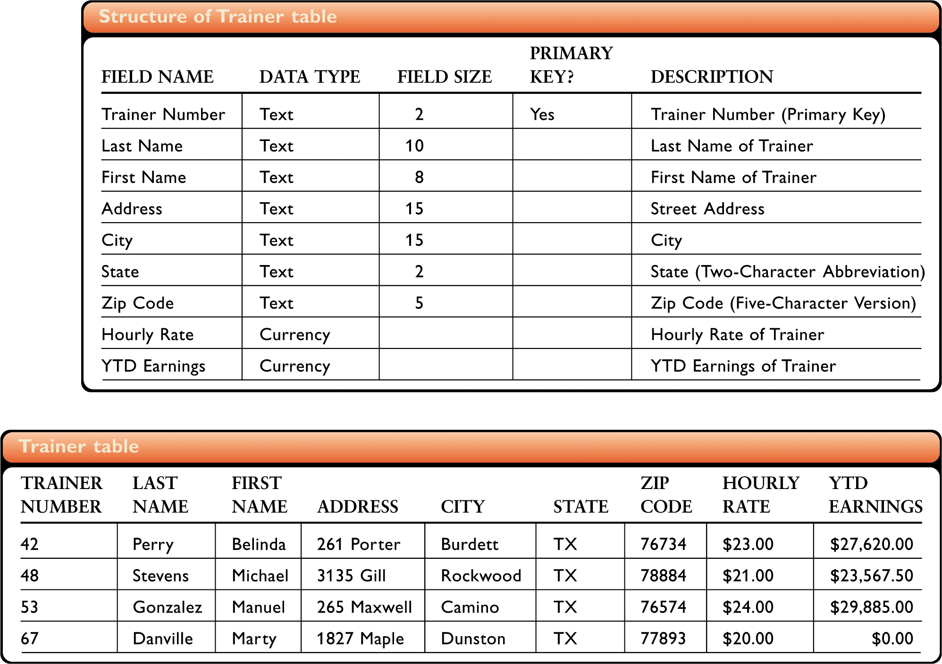
Creating an Additional Table

Slide 46
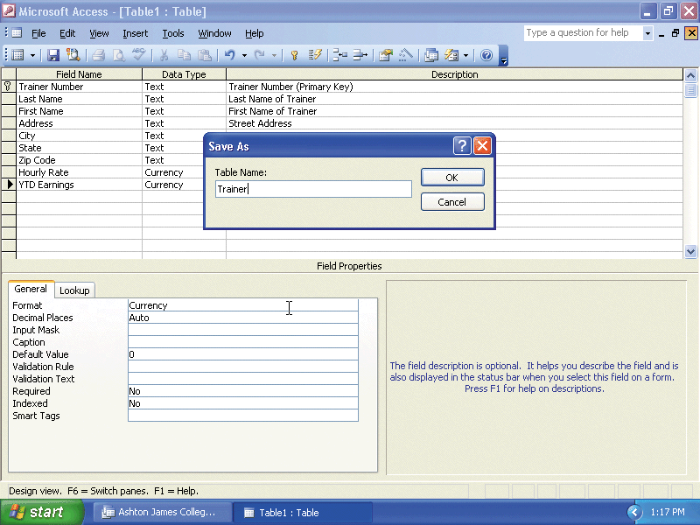
Creating an Additional Table

Slide 47
Adding Records to an Additional Table
Right-click the Trainer table, and then click Open on the shortcut menu. Enter the Trainer data from the figure on the following slide into the Trainer table
Click the Close Window button for the Trainer : Table window

Slide 48
Adding Records to an Additional Table

Slide 49
Using the Simple Query Wizard to Create a Query
With the Tables object selected and the Client table selected, click the New Object button arrow on the Database toolbar
Click Query on the New Object list
Click Simple Query Wizard, and then click the OK button
Click the Add Field button to add the Client Number field
Click the Add Field button a second time to add the Name field

Slide 50
Using the Simple Query Wizard to Create a Query
Click the Trainer Number field, and then click the Add Field button to add the Trainer Number field
Click the Next button, and then type Client-Trainer Query as the name for the query
Click the Finish button to complete the creation of the query
Click the Close Window button for the Client-Trainer Query : Select Query window

Slide 51
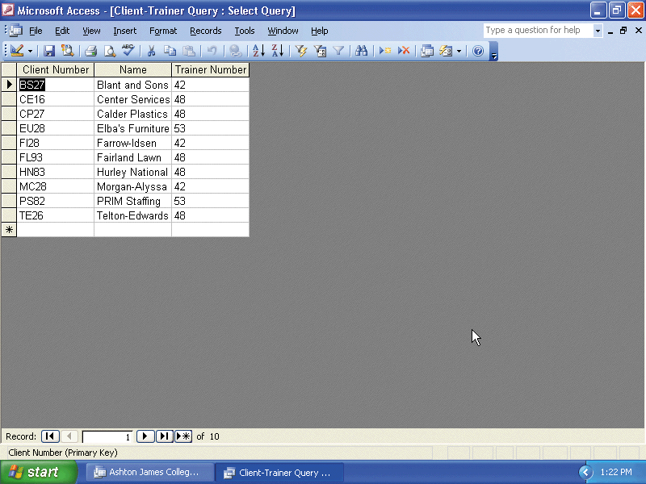
Using the Simple Query Wizard to Create a Query

Slide 52
Using a Query
If necessary, click the Queries object. Right-click the Client-Trainer Query
Click Design View on the shortcut menu
Click the Criteria row in the Trainer Number column of the grid, and then type 42 as the criterion

Slide 53
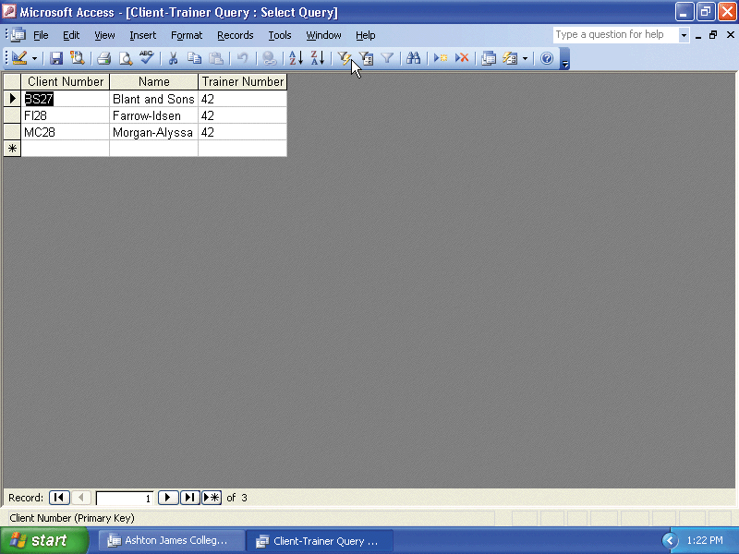
Using a Query
Click the Run button on the Query Design toolbar
Close the window containing the query results by clicking its Close Window button
When asked if you want to save your changes, click the No button

Slide 54
Using the New Object Button to Create a Form
Make sure the Ashton James College database is open, the Database window appears, and the Client table is selected
If necessary, click the Tables object on the Objects bar
Click the New Object button arrow on the Database toolbar
Click AutoForm on the New Object list

Slide 55
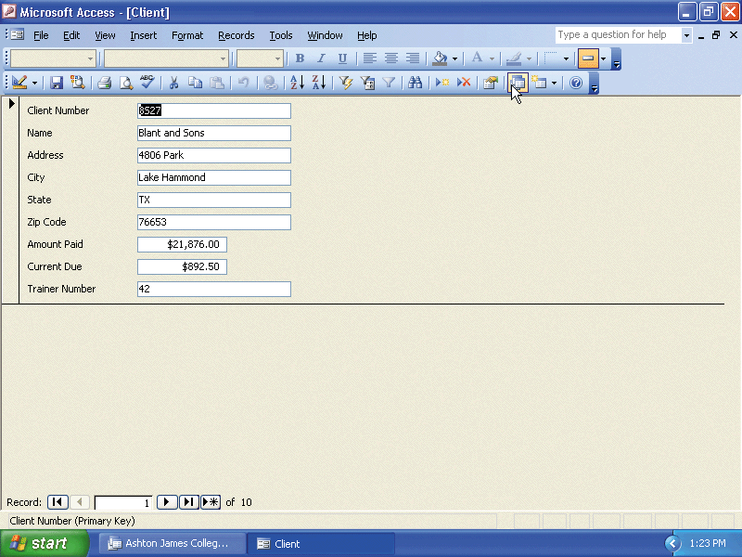
Using the New Object Button to Create a Form

Slide 56
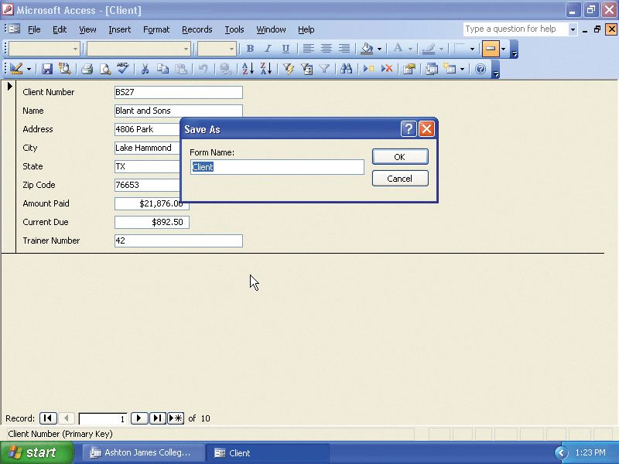
Closing and Saving a Form
Click the Close Window button for the Client window
Click the Yes button
Click the OK button

Slide 57
Opening a Form
With the Ashton James College database open and the Database window on the screen, click Forms on the Objects bar, and then right-click the Client form
Click Open on the shortcut menu

Slide 58
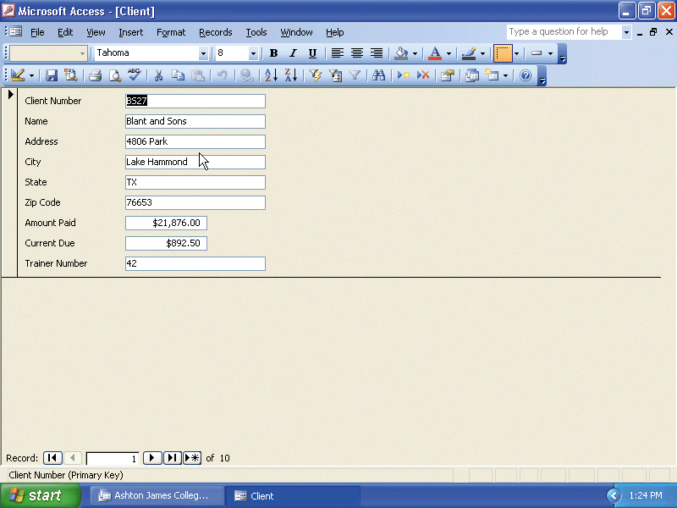
Opening a Form

Slide 59

Using a Form
Click the Next Record button four times

Slide 60
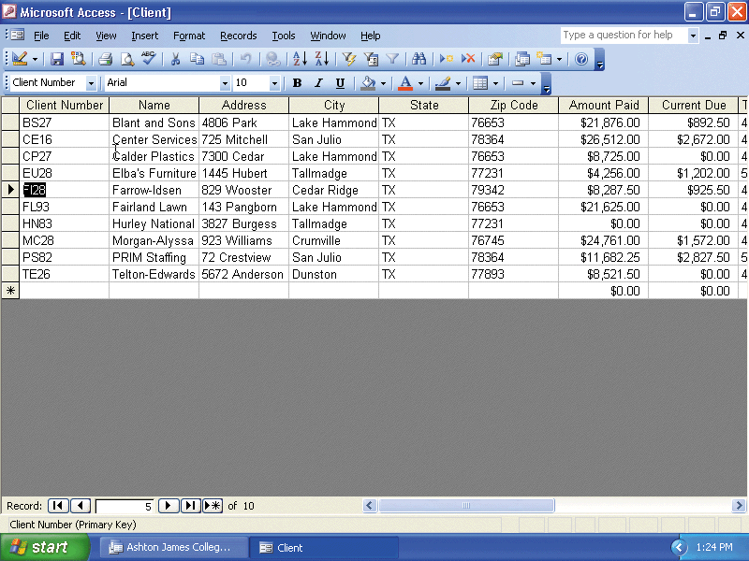
Switching from Form View to Datasheet View
Click the View button arrow on the Form View toolbar
Click Datasheet View
Click the Close Window button

Slide 61
Creating a Report
Click Tables on the Objects bar, and then make sure the Client table is selected
Click the New Object button arrow on the Database toolbar
Click Report
Click Report Wizard and then click the OK button
Click the Add Field button to add the Client Number field

Slide 62
Creating a Report
Click the Add Field button to add the Name field
Add the Amount Paid and Current Due fields just as you added the Client Number and Name fields
Click the Next button
Because you will not specify any grouping, click the Next button in the Report Wizard dialog box
Click the Next button a second time because you will not need to change the sort order for the records

Slide 63
Creating a Report
Make sure that Tabular is selected as the Layout and Portrait is selected as the Orientation, and then click the Next button
Be sure the Corporate style is selected, click the Next button, and then type Client Amount Report as the new title
Click the Finish button
Click the magnifying glass mouse pointer anywhere within the report to see the entire project
Click the Close Window button in the Client Amount Report window

Slide 64
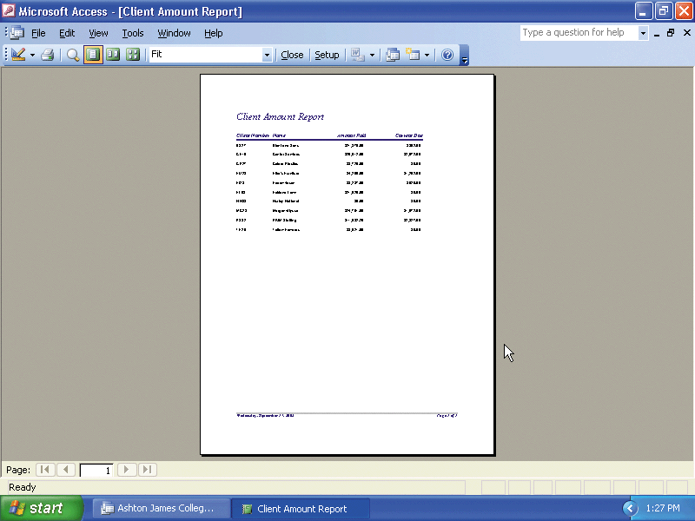
Creating a Report

Slide 65
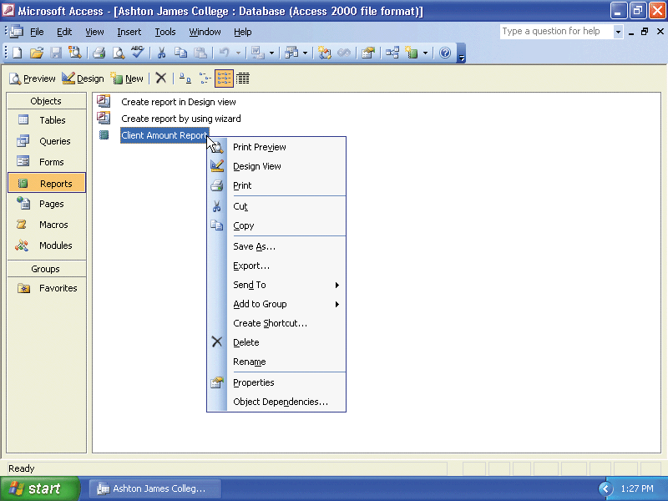
Printing a Report
If necessary, click Reports on the Objects bar in the Database window
Right-click the Client Amount Report
Click Print on the shortcut menu

Slide 66
Closing a Database
Click the Close Window button for the Ashton James College : Database window

Slide 67
Obtaining Help Using the
Type a Question for Help Box
Click the Type a question for help box on the right side of the menu bar
Type how do I remove a primary key in the box
Press the ENTER key

Slide 68
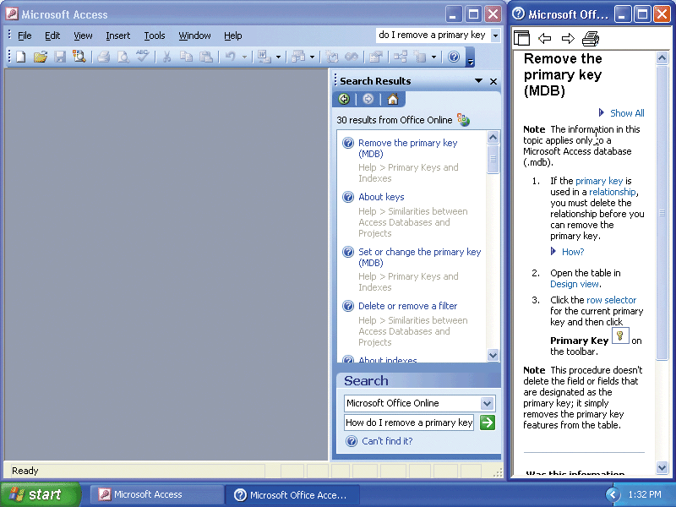
Obtaining Help Using the
Type a Question for Help Box
Point to the Remove the primary key (MDB) topic
Click Remove the primary key (MDB)
Click the Close button on the Microsoft Office Access Help window title bar

